Slide 1
The impact of socioeconomic status on students’ access to information on career thinking and exploration
Dawn Bennett (presenter), Paul Koshy, Ian Li, Jane Coffey, Mike Dockery

Slide 2
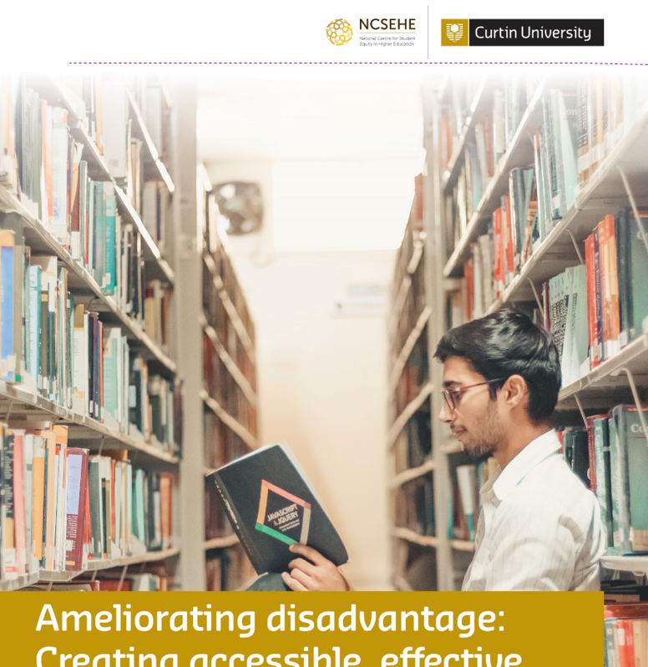
Ameliorating disadvantage: Creating accessible, effective, and equitable careers and study information for low socioeconomic students
Notes:
The OECD Career Readiness project emphasises the importance to young people of thinking about, and exploring, potential work futures. This presentation reports a study of how students’ access to information on career thinking and exploration differs by socioeconomic status (SES).

Slide 3
National Centre for Student Equity in Higher Education
www.ncsehe.edu.au
Notes:
Our study was funded by…

Slide 4
Study design
Notes:
To understand changes in career-related advice over more than two decades (n>59,000 responses), the researchers employed multivariate logistic regression analysis with data from the Longitudinal Surveys of Australian Youth (LSAY) and we undertook a literature review.
Next, we surveyed secondary school career advisors and career influencers across Australia. We had just under 100 responses.
We then analysed data from a freely available self-assessment tool via which university students reported their perceived employability (n=6,300), using multivariate linear regression.
We also talked with students at university and high school and with career practitioners and career influencers.

Slide 5
Understanding careers and study pathways support over time
Notes:
Inquiry 1 sought to better understand study pathways and careers support as experienced by students and influencers within low SES and other secondary schools. This involved a literature review and analysis of data from the Longitudinal Surveys of Australian Youth (LSAY).
The literature review paid particular attention to literature on students from low SES backgrounds. The review highlighted the paucity of research focused on study options, pathways, and careers for people from disadvantaged groups alongside inequitable access to career and study information given by qualified career practitioners.

Slide 6
Snapshot 1: Access to each type of information reported in Y98 LSAY cohort by SES quartile
Notes:
This figure shows the incidence of access to each type of information reported in Y98 LSAY cohort by SES quartile. A clear pattern is evident in which students from higher SES backgrounds were more likely to access information about university courses. This is also true of more general information about potential careers of interest, albeit with a less pronounced SES gradient. In contrast, for this cohort, coming from a lower SES background was associated with a higher likelihood of TAFE information.

Slide 7
Snapshot 2: SES gradients in participation for careers information for year 12 students from 2015
Notes:
Figure 7 depicts the SES gradients in participation for selected careers information activities for Year 12 students from 2015. All the careers information activities displayed significant differences across SES quartiles. Students from higher SES backgrounds were more likely to access information about university courses, while low SES students were more likely to access information on nonprofessional pathways.
This is a similar pattern to that seen in the 1998 data, collected 17 years earlier.

Slide 8
Findings from the LSAY data
Career and study information for senior high school students has increasingly focussed on traditional university pathways despite fewer than half of Australia’s university entrants engaging with these pathways.
The socioeconomic divide in the type and quality of career information available to students is becoming more pronounced.
Students from high SES backgrounds are more likely to access most forms of careers information.
Students from middle and high-SES backgrounds have greater access to formal sources of career information and human, social and cultural capitals through family, friends and social networks.
Low-SES students are more likely to receive information about non-university pathways. This trend was apparent in 1998 and continues to be the case.
Notes:
Extensive analysis of data from the LSAY collected between 1998 and 2015 focused on career guidance and information received by students in Years 11 and 12. The analysis drew on five LSAY cohorts launched in 1998, 2003, 2006, 2009, and 2015, and each commenced with nationally representative samples of around 14,000 high school students. These provided over 50,000 pooled observations for multivariate analysis of careers information accessed by students in Years 11 and 12.

Slide 9
Nation-wide survey of secondary school career advisors and influencers
Notes:
The OECD Career Readiness project emphasises the importance to young people of thinking about, and exploring, potential work futures. This presentation reports a study of how students’ access to information on career thinking and exploration differs by socioeconomic status (SES).

Slide 10
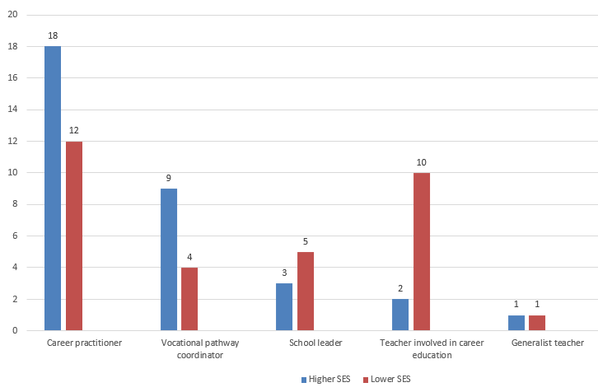
Provision of career and study pathways guidance by SES school status in the year 2020
Notes:
Career and study pathways guidance in lower SES schools is more likely to be provided by staff who are not qualified career practitioners. Qualified career practitioners in lower SES schools tend to be less experienced than their peers.

Slide 11
Only 31% of career practitioners from lower SES schools and 55% of practitioners from higher SES schools reported that the study pathway support they provided was fit for purpose.
Notes:
Only 31% of career practitioners from lower SES schools and 55% of practitioners from higher SES schools reported that the study pathway support they provided was fit for purpose.
detailed careers information in Year 1
Career practitioners and influencers across all settings reported being undervalued and overworked, with insufficient time and/or human resources to meet students’ needs; respondents from lower SES schools also reported limited financial resources. Although career practitioners and influencers reported that they could provide adequate guidance with their existing time and resources, students who participated later in the study disagreed that the support and guidance available to them had met their needs.
Survey data in this study were split into two categories for analysis, with schools with an ICSEA score of 0 to 54 classified as lower SES and the remaining schools (ICSEA score 55 to 99) classified as higher SES.
0.

Slide 12
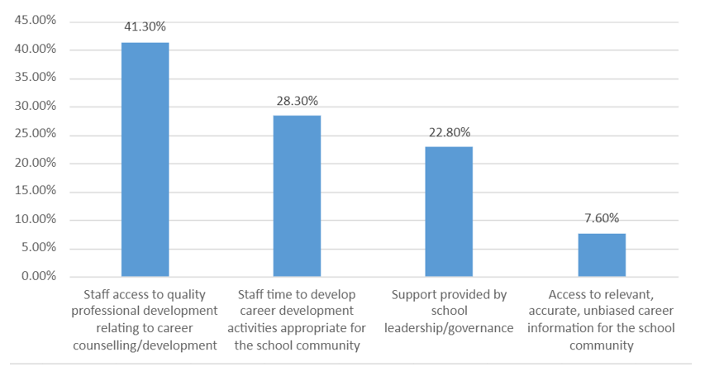
Challenges to the provision of career guidance and study pathways support
Notes:
Career and study pathways guidance in lower SES schools is more likely to be provided by staff who are not qualified career practitioners. Qualified career practitioners in lower SES schools tend to be less experienced than their peers.

Slide 13
Student confidence
Notes:
Inquiry 2 employed and analysed data from Bennett’s (2019a) social cognitive measure of perceived employability, which encompasses 16 aspects of study and career confidence ranging from academic self-efficacy to communication skills. Data from 6,300 participating students at three Australian universities were linked with institutional and national datasets to compare the confidence of university students from low SES backgrounds with that of their peers.

Slide 14
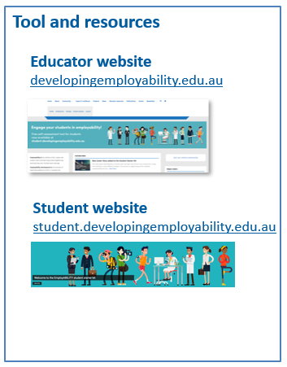
The open access Employability self-assessment tool

Slide 15
Key findings
Students from government (state) schools, regardless of SES, were disadvantaged in relation to employability thinking and preparation.
The impact of the inequitable provision of careers and study information in secondary school is long-lasting. Coupled with disruptions such as the pandemic, the impact of disadvantage in higher education is likely to be exacerbated.
SES background may mediate access to higher education, but once there, low SES students are not dramatically different from their peers in both conceptualising and finding institutional support for their career aspirations.
Notes:
Inquiry 2 employed and analysed data from Bennett’s (2019a) social cognitive measure of perceived employability, which encompasses 16 aspects of study and career confidence ranging from academic self-efficacy to communication skills. Data from 6,300 participating students at three Australian universities were linked with institutional and national datasets to compare the confidence of university students from low SES backgrounds with that of their peers.
Overall, the limited indication of a statistically significant difference between students from low SES backgrounds and others, across various measures of SES, particularly once ATAR was included as an explanatory variable, suggests that low SES background may play a mediating role in restricting entry into higher education (see Dockery et al., 2016), but once there, low SES students are not dramatically different from those of the general student population in both conceptualising and finding institutional support for their career aspirations.

Slide 16
Student focus groups
Notes:
Inquiry 2 employed and analysed data from Bennett’s (2019a) social cognitive measure of perceived employability, which encompasses 16 aspects of study and career confidence ranging from academic self-efficacy to communication skills. Data from 6,300 participating students at three Australian universities were linked with institutional and national datasets to compare the confidence of university students from low SES backgrounds with that of their peers.

Slide 17
Notes:
Informed by the results of Inquiries 1 and 2, Inquiry 3 involved focus group interviews with 54 secondary school and undergraduate students. The focus groups were designed to enable students from low SES backgrounds to comment on the findings of Inquiries 1 and 2 and to speak of their experiences of study and career education.
Key influencers identified by participants in their career and study pathways were described as enablers or “Door Openers”, and constrainers were labelled “Dream Killers”. Door Openers were often receptive to participants’ goals and helped them navigate challenges, regardless of their present study pathway (General, VET, or ATAR). Dream Killers, however, often saw study pathways as rigid and discouraged students, often quite harshly, from pursuing careers outside these rigid pathways. I want to share a story. You will hear both a dream killer and a door opener in this story.
I was pushed into VET, really. Everything just happened at once. They spent a week throwing information at us about subjects and jobs and uni. All in the same week, they wanted me to figure out what I wanted to do. The school was very focused on pushing VET kids into their corner. The deputy principal, Mr. C., when it came to picking subjects he was focused on picking subjects with ATAR students. He didn’t actually help me pick subjects that would get me to uni., which is what I wanted. I said I wanted to do ATAR and he checked my grades on the computer. He looked at me with that look that said, “Oh honey, don’t get your hopes up”. He just handed me a yellow slip with the certificate courses that were offered at the school. The ATAR subjects were crossed off. You’re either a TAFE kid or an ATAR kid. I wasn’t smart enough for ATAR. I was pushed to the side. Angry. Dream crusher. I want to do better. My mum wants me to be better.
I went to you, the one teacher that had helped me when I first came to the school. You were, like, the main one all of us went to. You just had a way of telling me things. And you didn't just blurt it out and expect me to understand straight away. You gave me a chance to think about it. And if I didn’t get it, you’d explain it easier for me. You organised trips to go and see people who were working in jobs like engineering and stuff. That’s where I first got the idea of going to uni. You taught maths and knew my score. I showed you the yellow slip and you frowned. At the assembly, you found me, took my hand and marched to Mr. C.
“She will be in my class next year because even if she’s not getting the grades that she needs. I know that she’s passionate about it and that’s all that’s important”, you declared confidently as I stared at you. Mr. C. looked unsure. “I vouch for her”, you added.
It took my Mum having to really push and shove, and also getting my teachers, my other teachers, to back me up on it, to then push me across that line. In Year 11 and 12 I studied a VET course and ATAR maths and now I’m working towards uni. doing a bridging course. You treated me like a person and I had people to guide me and believe in me. That’s how I survived high school.

Slide 18
Key findings
Notes:
Inquiry 2 employed and analysed data from Bennett’s (2019a) social cognitive measure of perceived employability, which encompasses 16 aspects of study and career confidence ranging from academic self-efficacy to communication skills. Data from 6,300 participating students at three Australian universities were linked with institutional and national datasets to compare the confidence of university students from low SES backgrounds with that of their peers.

Slide 19
Irrespective of a school’s location, type, or SES, career and study guidance in Australian schools is often limited to subject selection based largely or entirely on academic grades.
In line with the literature, Australian students’ postsecondary decision-making appears to be based almost entirely on academic performance. In-depth discussions about careers, study pathways, and individual interests are rare.
Study pathways information is significantly skewed towards university study, and students are uninformed about alternative pathways into postsecondary education.
Students feel valued by their schools only if they are on a university pathway.
Notes:
Focus group participants revealed that irrespective of a school’s location, type, or SES, career and study guidance in Australian schools is often limited to subject selection, with this based largely or entirely on academic grades. Moreover, guidance typically takes the form of a single short meeting after which students are streamed into classes that focus exclusively on university entrance or other pathways.
In line with the literature, Australian students’ postsecondary decision-making appears to be based almost entirely on academic performance, and in-depth discussions about careers, study pathways, and individual interests are rare. Study pathways information is also significantly skewed towards university study, and students are uninformed about alternative pathways into postsecondary education. Unprompted, participants in every focus group reported that students felt valued by their schools only if they were on a university pathway.

Slide 20
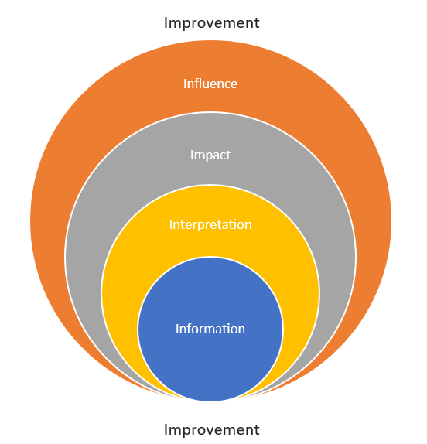
The 5 Is of student career and study pathways support
Information and guidance provided to students
Students’ interpretation of the information and guidance they receive
Influence of information and guidance on stakeholders
Temporal impacts of information and influence
Improvements to students’ access to and use of study and career pathways information.
Notes:
In the final phase, the themes and issues identified by students were compared with the findings from the LSAY analysis (Inquiry 1) and students’ self-assessments of career and study confidence (Inquiry 2). Combined, the study findings informed five elements through which students’ career and study decision-making might be understood and enhanced:

Slide 21
Conclusions
Effective career and study guidance is dependent on students’ (unequal) access to qualified career practitioners or to teachers with career guidance duties and little or no training.
Despite considerable attention, we find there to be inequitable provision of careers and study information from the early years of secondary school. The impacts of this are long-lasting.
The COVID-19 pandemic is the most recent of numerous factors that adversely impact disadvantaged students. Without urgent action, the impacts of disadvantage will become irreparable.
Policymakers and sector leaders need to collaborate on bipartisan solutions.
Careers information should introduce multiple study and career pathways, and these pathways should be valued equally.
Notes:
The study concludes that effective career and study guidance is dependent on students’ (unequal) access to qualified career practitioners or, in many cases, to teachers with career guidance duties and little or no career and study guidance training. In cases where there is no qualified practitioner, Australian students are mystified by the multiple, state-based pathways they see online or in generic fliers. The result is that many Australian students base essential career and study decisions on information from parents, peers, and social media.
Students from disadvantaged groups experience higher rates of postsecondary attrition and deferral and poorer graduate employment outcomes. Despite considerable attention, we find there to be inequitable provision of careers and study information from the early years of secondary school. The impacts of this are long-lasting.
The COVID-19 pandemic is the most recent of numerous factors that combine to adversely impact disadvantaged students. The lessons of previous recessions and other macro-economic disruptors highlight that the immediate and longer term impacts of the pandemic will be felt most keenly by students and workers with disadvantage. We conclude that without urgent action, the impacts of disadvantage will become irreparable, exacerbated by an increasingly diversified student population, labour market changes marked by the fourth industrial revolution, and the longer term impacts of COVID-19.
The study outcomes have significant potential to improve access to effective careers and study information, with a particular focus on students from disadvantaged groups and those who seek to assist them. We urge policymakers and sector leaders to collaborate on both short-term and longer term bipartisan solutions. We advocate for careers information that introduces multiple study and career pathways and that these pathways be valued equally. The following recommendations are made to advance these aims.

Slide 22
Recommendations for broad reforms and enhanced BI
Develop a national approach to ameliorating the inequitable provision of career and study pathways guidance.
Establish a nation-wide repository of student-centric career and study information that enhances students’ ability to make informed choices and connect with expertise.
Craft a national approach to assisting students and career influencers to navigate the postsecondary environment across jurisdictions.
Found a national approach to the collection and analysis of data in relation to secondary pathways and education-to-work reporting.
Create national datasets with which to examine the changing role of disadvantage in career guidance.
Include the student voice in policymaking.

Slide 23
Recommendations to enhance career education in schools
Recognise
Recognise the career practitioner role as being critical to the core business of schools.
Ensure
Ensure that career education is undertaken by qualified practitioners in conjunction with trained educators.
Extend
Make sure that career and study pathways guidance is universal and extends across the student lifecycle.
Incorporate
Incorporate initial career development information in preservice teacher programs.

Slide 24
Thank you!
Professor Dawn Bennett
dabennett@bond.edu.au

